Slide 1
Session 46 : Android Audio API
Module 4.3 : Android

Slide 2
Learning Objectives
At the end of the session successful participants will be able to
Understand complexity of android audio system
Understand Architecture of Audio System
Understand Audio Flinger

Slide 3

Architecture Audio System
The complexity of android audio system
Soft real-time requirement
Large number of usage scenarios
Software
phone/media player/…
different volume setting/…
Hardware
earpiece/speaker/hdmi/…
mic/bluetooth/…
Flexibility design
good design pattern
performance (Java/JNI/binder/…)
Notes:
有些能關有些不能關
有新裝置時聲音要轉移
同一個東西在不同地方有不同名稱
裝置有 FM
7.1 聲道

Slide 4
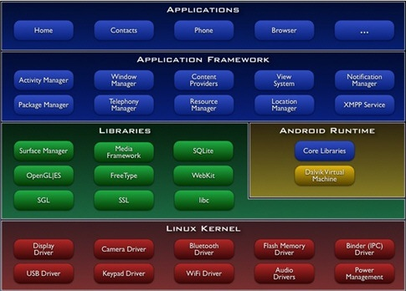
Architecture Audio System
Java App
Android Framework
Audio HAL
Linux Driver

Slide 5
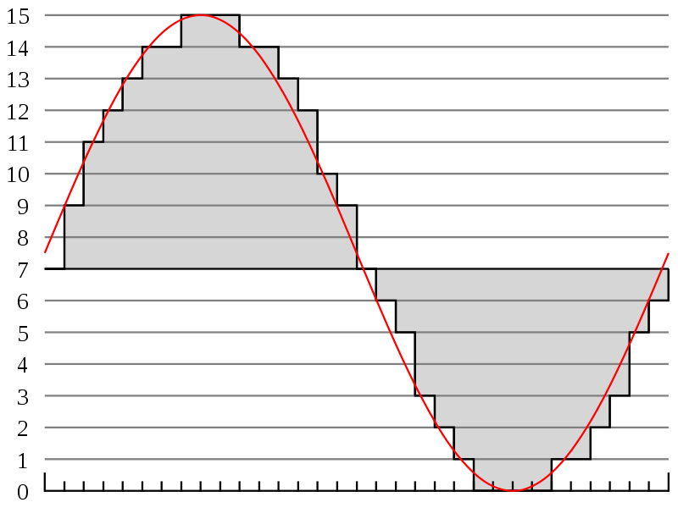
Android Audio System
app
pcm data
data flow
Audio Policy
Audio Flinger
AudioTrack/AudioRecord/…
(AudioPolicy/AudioFlinger/…)
control flow
Audio HAL
(open/read/write/…)
Audio Driver

Slide 6
Audio Framework

Slide 7
Audio Framework
Network Packet Routing
sender 1
router
receiver 1
sender 2
Routing path
receiver 2
sender 3
receiver 3
sender 4

Slide 8
Audio Framework
Audio Routing (play audio)
AudioTrack 1
Audio Policy
Hardware 1
AudioTrack 2
Audio Flinger
Hardware 2
AudioTrack 3
Hardware 3
AudioTrack 4
Java App
Audio Framework
Audio HAL
Notes:
只講 play 部份，record 反之亦然
有其他諸如 Audio System 之類的裝置管理沒講

Slide 9
Audio Policy
Decide which thread in AudioFlinger should sound be attached.
stream → strategy → output
stream : VOICE_CALL, TTS, MUSIC, …
strategy : PHONE, MUSIC, …
output : a thread in AudioFlinger
strategy : bridge between software data stream and hardware

Slide 10
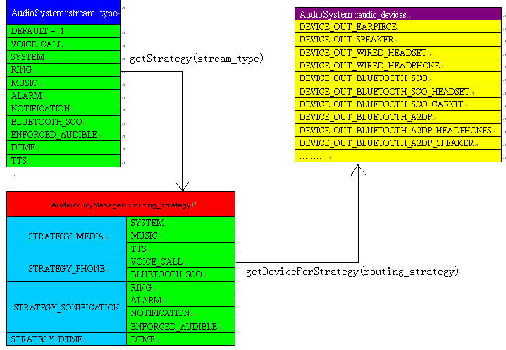
Audio Policy

Slide 11
Audio Policy
IOProfile (audio_policy.conf)
Content
Define all the possible I/O devices
Define default I/O device
Hierarchical structure
hardware module
profile
sampling_rates/channels/formats/devices/flags
With IOProfile, audio policy gets better OO structure.

Slide 12
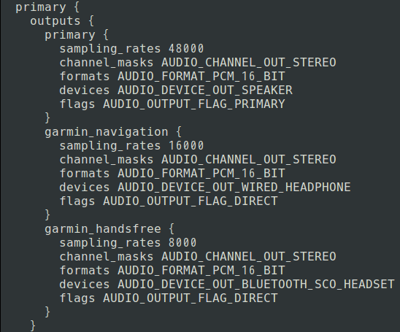
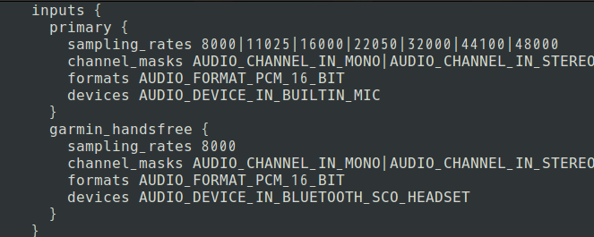
Audio Policy

Slide 13
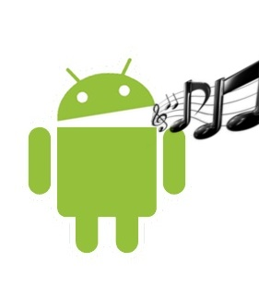
Audio Flinger
Several thread to read/write data
Create thread by AudioPolicy
mixer thread
duplicating thread
direct output thread
Resampler
Non-blocking audio I/O
AudioWatchdog
Notes:
4.0 -> 4.2 自 7xxx ~ 9xxx (Leo 3926)
相關的自 14xxx ~ 20xxx
TODO : 5 ~ 9
FIXME : 4 ~ 28

Slide 14
Audio HAL

Slide 15
Audio HAL
app
AudioTrack/AudioRecord/…
(AudioPolicy/AudioFlinger/…)
Audio HAL
(open/read/write/…)
Audio Driver
Notes:
1. The original version is provided from
SoC vendor.
2. Dynamic library linked by
AudioFlinger.

Slide 16
Audio HAL
ALSA (Advanced Linux Sound Architecture)
unified interface/SMP/thread-safe/…
usespace library
alsa-lib
tinyalsa
tinyplay/tinycap/ tinymix
Audio HAL interface
volume setting
I/O function
…
Notes:
Why use Tinyalsa
We can use ALSA-lib substitute for Tinyalsacompletely, but we can’t use Tinyalsa substitute for ALSA-lib completely. But,in some times, Tinyalsa can substitute for ALSA-lib to work for some basicfunction.
The only reason is that it is smaller and simpler than ALSA-lib.
Google Android supplies the Tinyalsa.
Audio HAL interface forms changed in Android 4.0.

Slide 17
Media API
Audio/Video
Playback
Record
android.media.MediaPlayer
android.media.MediaRecorder

Slide 18
Playback: MediaPlayer Basics
Play Media From:
Resource Folder
File System Path
URL
Basically
Create new instance of MediaPlayer
Call prepare()
Call start()

Slide 19
Playback: MediaPlayer Class
Set:
Audio Stream
Output Display
Looping
Data Source
Wake Mode
Listeners:
Buffering Update
Completion
Error
When Prepared
Create Using:
URI
Resource ID
URI + Surface
Others:
Start
Prepare
Pause
Release
Reset
SeekTo
Stop
Get:
Position
Duration
FrameAt
Inherits from
java.lang.Object

Slide 20
Recording: MediaRecorder
Create new instance of MediaRecorder
Create new instance of ContentValues
Create an output file
Set Preview Display
Set Video and Audio Source (Camera and Mic)
Set Properties (File Size, Video Size, Frame Rate)
Set Audio and Video Encoders
Call Prepare() and Start()
Call Stop() and Release()

Slide 21
Uses of Media API
Call:
Receiving – Start mp3 background service
Automatically record conversation or 3G videos
Playing Games:
Sound mp3’s in background, render video in foreground
Clicking buttons sound small ticks (mp3’s)
Conference:
Recording and Playback of Mobile Conference
Synchronising Playback via Bluetooth on Projector
Record Sounds or Movements, Transform into Actions

